Slide 1
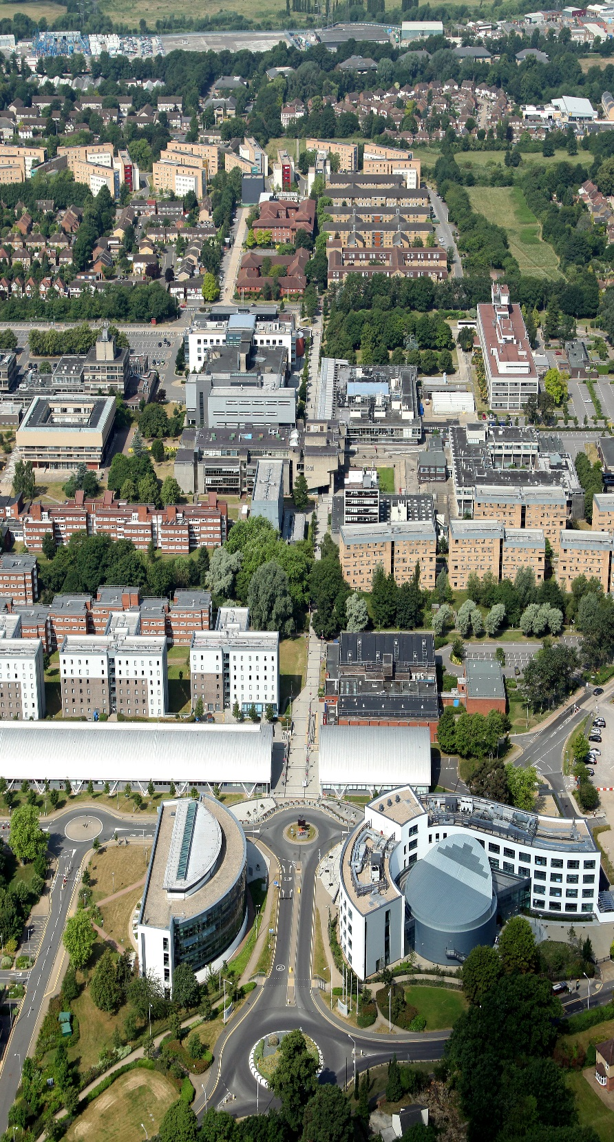
Gesture Correctness Estimation with Deep Neural Networks and Rough Path Descriptors
By: Noureddin Sadawi
ICDM-SSTDM19 workshop
08/11/2019

Slide 2
Collaboration with:
Crina Grosan, Senior lecturer and project leader at Brunel University – London
Alina Miron, Lecturer at Brunel University – London
The 14th International Workshop on Spatial and Spatio-Temporal Data Mining - International Conference on Data Mining 2019

Slide 3
Contents
Introduction
The Problem
The Data (also Data Visualisation and Augmentation)
Method 1: Convolutional Neural Network (CNN)
Method 2: Long Short-Term Memory network (LSTM)
Method 3: Rough Path Theory (RPT) Signatures as features
Experimental Results
Challenges
Summary and Conclusions

Slide 4
Introduction
Human movement (or gesture) recognition is a classical computer vision problem which deals with identifying a certain movement from a set of available movements
The problem can be addressed using either colour or depth images, or simplified by taking the angles (represented in degrees) between different body segments or the 3D positions (represented in millimetres) of various body joints
A human action usually lasts from several seconds to a few minutes
Data is spatio-temporal (a sequence of frames or images in time)

Slide 5
The Problem
The main contribution of our research is that we do not focus on action or gesture recognition
We expand the research to gesture correctness
However, technically speaking, although a binary classification problem (determine whether an action is correctly executed or not), this problem is much more complex than just action recognition
There is very limited work in the area of human action or movement correctness

Slide 6
The Data
Human action/motion 3D skeleton data captured using motion sensor devices
Collected using Kinect sensor
Contains angles and positions of several body joints
Each joint is represented by three coordinates
Data collected for several gestures (e.g. elbow flexion, shoulder abduction)

Slide 7
The Data
Collected as part of a collaborative project from Perkeso Tun Razak Rehabilitation Centre, Malacca, Malaysia
17 patients and 14 healthy individuals performing nine types of gestures
These are real patients and not actors
In terms of correct/incorrect annotations, the gestures were independently annotated by two annotators
It will be made freely available online soon

Slide 8
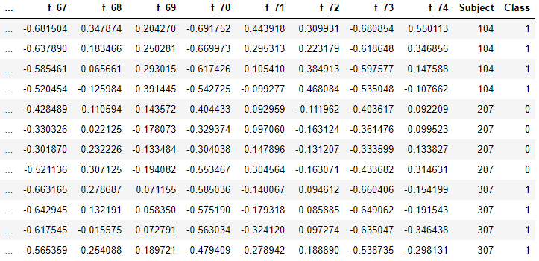
Data Contents
Each joint is represented by three coordinates (columns)
This example contains positions of 25 joints

Slide 9
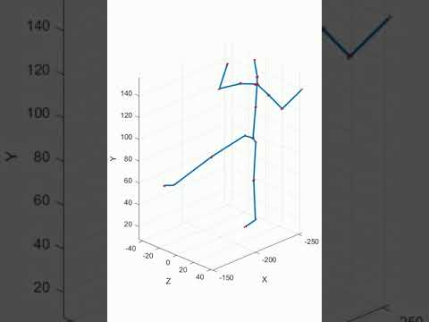
Data Visualisation
https://www.youtube.com/watch?v=RyObs6bdZYo

Slide 10
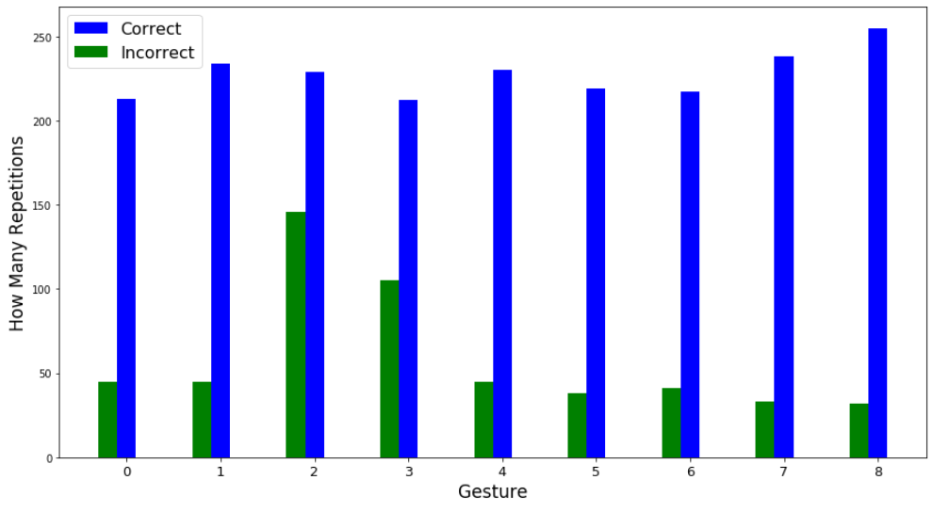
Data Distribution
Data is highly unbalanced
Much more correct gestures than incorrect

Slide 11
Data Augmentation
Data augmentation is a way of creating new 'data' with different orientations
The benefits of this are two-fold:
The ability to generate 'more data' from limited data
It prevents overfitting
Currently we have several techniques such as Jittering, Scaling, Permutation, Rotation and Time Warping

Slide 12
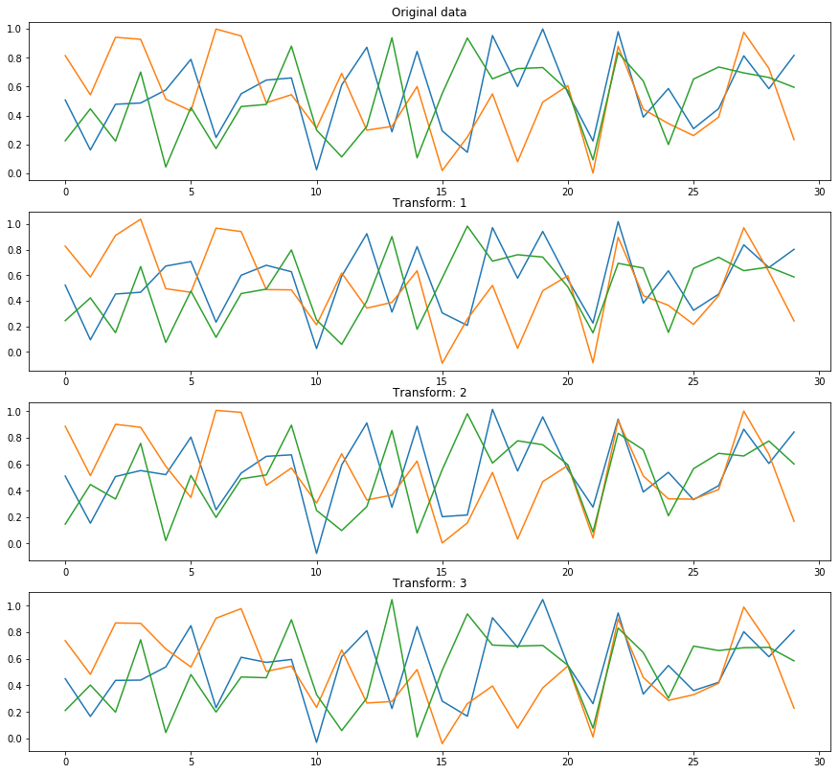
Data Augmentation Example

Slide 13
Convolutional Neural Networks (CNNs) 1/2
CNNs work by generating filters (aka kernels) that capture patterns in the data
Most common application is image analysis (2D or 3D kernels)
We use CNNs for time-series analysis by learning 1D filters
Dimension of data is normally reduced as we add more convolutional layers (can keep original dimension)
Pooling layers are also used to reduce dimension further
Filter size, how much to move (stride), pooling type are subject to experimentation
Dropout technique to avoid overfitting

Slide 14
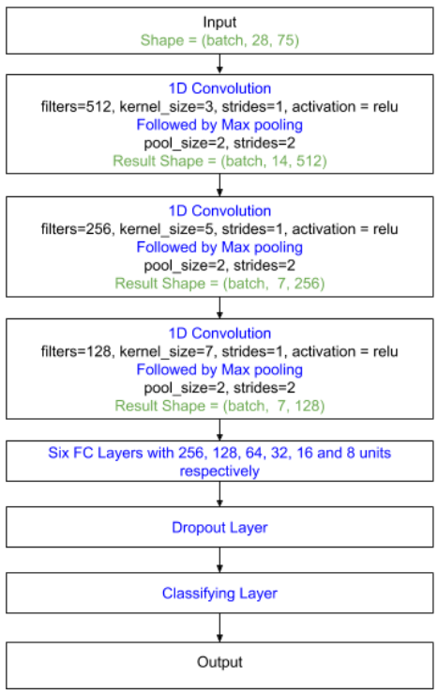
Convolutional Neural Networks (CNNs) 2/2
CNNs are known to work well on temporal data (several application areas)
Usually data format is crucial (how to feed them data)
Known to be data hungry (hence data augmentation is often used)

Slide 15
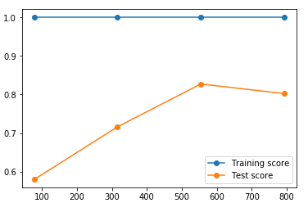
Long Short-Term Memory Network (LSTM)
Units of a recurrent neural networks (RNNs)
Remembers values over arbitrary time intervals
Well-suited to classifying, processing and making predictions based on time series data
But .. requires plenty of data
See learning curve on the right
Accuracy on Test Data
Number of Training Instances

Slide 16
Rough Paths Theory 1/2
This is a powerful signature method for sequential data representation and feature extraction
It is derived from the theory of rough paths in stochastic analysis
Given a path (time series), it extracts a unique feature vector
No matter how long the series is (i.e. number of time points is irrelevant)
Size of resulting signature (i.e. feature vector) is the same
Works well in many areas (e.g. financial data)

Slide 17
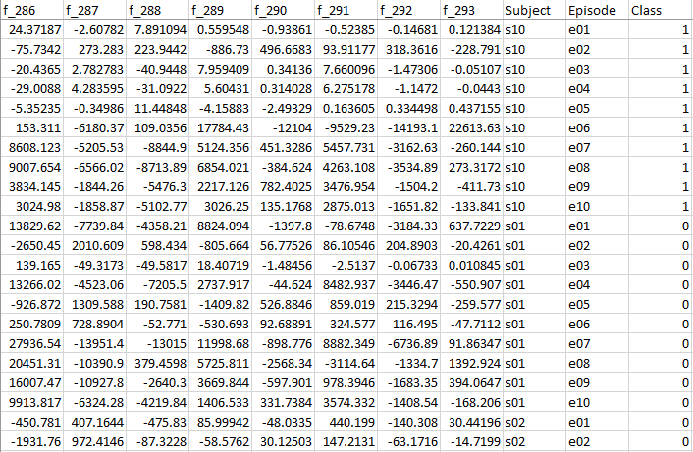
Rough Paths Theory 2/2
In our case, each move (regardless of how many frames it has) is represented by one feature vector
This means each move becomes one instance
This makes classification (predict if a move is right/wrong) easy!

Slide 18
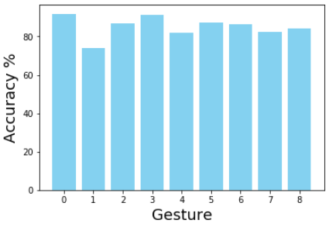
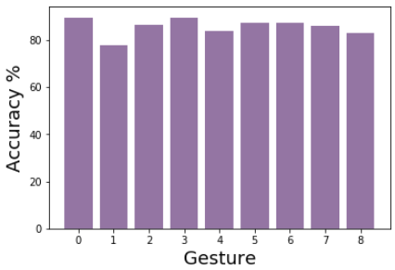
Current Results – CNN and LSTM
CNN
LSTM
Average accuracy of our CNN and LSTM architectures on each gesture
Evaluation is done using leave one subject out (LOSO) method

Slide 19
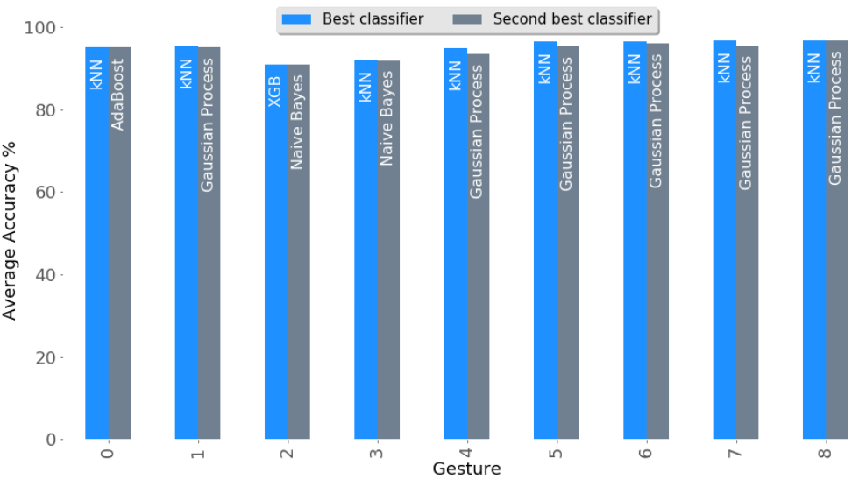
Current Results – Rough Path Descriptors
Using rough path descriptors
Performance of a collection of classifiers using the LOSO method

Slide 20
Challenges
Currently rough path descriptors followed by kNN classifier yields the best average results
Extracting rough path descriptors is slow
Cross-subject evaluation is challenging but this ensures that the trained model can generalize to new subjects
There is a great variability in how the gestures are executed
CNNs and LSTMs are data hungry so the size of the dataset is a disadvantage for them
Their average accuracy on this data is very similar

Slide 21
Summary and Conclusions
Experiments performed on the Perkeso data
Evaluation on subjects not used for training the models (cross-subject evaluation)
Currently best is RPT with kNN algorithm
Average accuracy is > 95%
General performance of our CNN and LSTM is similar
We are working on improving this even further
Code available at: https://github.com/nsadawi/gesture-correctness

Slide 22
