Slide 1
Constraint Satisfaction Problems and Constraint Programming
Brunel BSEL/IDA seminars, 6 November 2019
Gabriel Scali

Slide 2
Constraint Satisfaction Problems

Slide 3
Constraint Satisfaction Problems
A constraint satisfaction problem (CSP) is a tuple (X,D,C) where:
X = {x₁, x₂, . . . , x_{n}} is the set of variables
D = {d₁, d₂, . . . , d_{n}} is the set of domains (d_{i} is a finite set of potential values for x_{i})
C = {c₁, c₂, . . . , c_{m}} is a set of constraints restricting the values that the variables can simultaneously take.
Values need not be a set of consecutive integers, they just need to be a discrete set.
A solution to a CSP is an assignment of a value from its domain to every variable, in such a way that all constraints are satisfied at once.
Just any solution vs all solutions vs a good/optimal solution.
In this last case, we have a constrained optimisation problem (COP), defined by some objective function of some (or all) of the variables

Slide 4
Complexity of CSPs
CSPs are in general NP-complete.
This easily follows by a number of other NP-complete problems being expressible as constraint satisfaction problems: for example the propositional satisfiability (SAT) problems.
Research has shown that some subclasses of CSPs with certain properties are polynomial if they follow certain restrictions. For example an instance where all the domains are binary and all the constraints are binary, can be solved in polynomial time.
COPs are harder than their corresponding CSPs: knapsack and TSP are reducible to COPs.
Puzzles such as the n-queens problem or sudoku are often used as toy examples.

Slide 5
Why are CSPs and CP interesting?
CSPs and COPs appear in all sorts of fields: scheduling, planning, resource allocation, transport and logistics, network management, economics, biology and many more.
Unlike it happens for other areas of AI, this is one where computers, while struggling, are still much better than people!
In the holy wars between different programming paradigms, declarative and constraint programming are often unjustly neglected - but there are strong arguments in favour of them, especially in terms of the software engineering practices they enable.

Slide 6
Solving CSPs : backtracking
Finding a satisficing assignment is a search problem on (possibly infinite) tree.
The simplest CSP-solving technique is backtracking, that consists in incrementally extending a partial solution that specifies consistent values for some of the variables, towards a complete solution, by repeatedly choosing a value for another variable consistent with the values in the current partial solution.
This is often not very effective for a few reasons:
repeated failures due to the same reason;
conflicting values of variables are not remembered;
conflicts are not detected before they really occur.

Slide 7
Solving CSPs : constraint propagation
A better method for solving CSPs is based on removing inconsistent values from variables’ domains as new values are assigned. These consistency techniques were introduced first in the scene labelling problem (1975) and are based on the concept of constraint propagation.
CSP can be represented as a constraint graph where nodes correspond to variables and edges are labelled by constraints.
The most widely used consistency technique is called arc consistency (AC). It removes inconsistent values from variables’ domains based on binary constraints. In particular, the arc (V_{i},V_{j}) is arc consistent if and only for every value x in the current domain of V_{i} which satisfies the constraints on V_{i} there is some value y in the domain of V_{j} such that V_{i}=x and V_{j}=y is permitted by the binary constraint between V_{i} and V_{j}.
Other, more sophisticated algorithms have been introduced over the years, based on things like path consistency, lookahead, and look back techniques such as backjumping or backmarking.
Notes:
Even more inconsistent values can be removed by path consistency (PC) techniques. Path consistency requires for every pair of values of two variables X, Y satisfying the respective binary constraint that there exists a value for each variable along some path between X and Y such that all binary constraints in the path are satisfied. It was shown by Montanari (1974) that CSP is path consistent if and only if all paths of length 2 are path consistent. Therefore path consistency algorithms can work with triples of variables (paths of length 2). There exist several path consistency algorithms like PC-1 and PC-2 but they need an extensive representation ({0,1}-matrix) of constraints that is memory consuming.

Slide 8
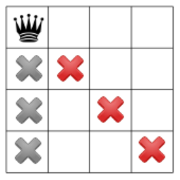
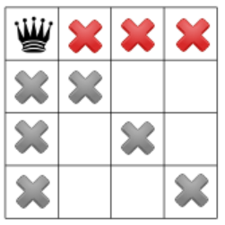
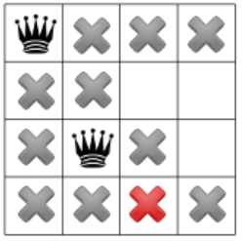
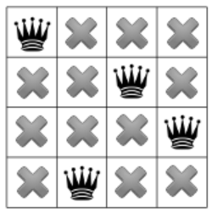
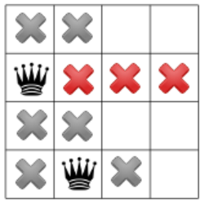
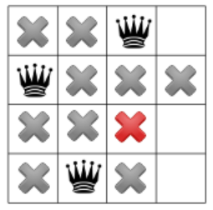
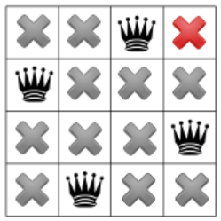
N-Queens problem and constr. propag.

Slide 9
Solving CSPs : beyond systematic search
In most problems encountered in real-world applications systematic searches are unfeasible, even using the mentioned techniques.
There are three alternatives:
Construction heuristics: policies for choosing which variable to assign next and which available value to assign next based on the nature of the problem.
Local search: start with an unfeasible solution and use a repair metaphor to improve it. E.g. hill-climbing or tabu search. LS usually has some form of randomisation to get out of local minima.
Global search: e.g. genetic algorithms, look at the space of assignments as a whole.

Slide 10
Constraint Optimisation Problems
COPs are even harder than CSPs.
The most famous systematic algorithm is Branch and Bound.
B&B needs a heuristic function that assigns a numerical value to a partial labelling. The value represents an underestimate (for minimisation) of the objective function for the best complete labelling obtainable from the partial labelling. Solutions are searched depth first like with backtracking, but as soon as a value is assigned to a variable, the value of heuristic function is computed. If it exceeds the bound, then the sub-tree under the current partial labelling is pruned. Initially, the bound is set to infinity and during the computation it records the value of best solution found so far.
The efficiency of B&B is determined by two factors: the quality of the heuristic function and whether a good bound is found early.
Again, systematic search not usually feasible in real problems, so a number of heuristic and metaheuristic techniques are the subject of much research.
Notes:
B&B (Land & Doig, 1960; Lawler & Wood, 1966)

Slide 11
Constraint Programming

Slide 12
Google or-tools and other solvers
Constraint programming is the study of computational systems based on constraints.
The idea of constraint programming is to solve CSPs and COPs by just stating variables with their domains, and constraints (requirements) about the problem area.
Then letting a generalised solver find solution satisfying all the constraints.
This paradigm has been first incorporated as an extension to logic programming languages, originating Constraint Logic Programming, but adding some sort of constraint declaration extension to all sorts of languages of various paradigms.

Slide 13
“Constraint Programming represents one of the closest approaches computer science has yet made to the Holy Grail of programming: the user states the problem, the computer solves it.”
Eugene Freuder, Emeritus Professor of Computer Science at University College Cork
E. Freuder. 1996. In pursuit of the Holy Grail. ACM Computing Surveys 28, 4es, Article 63 (December 1996).
Notes:
The scene labelling problem is probably the first constraint satisfaction problem that was formalised. Finding combination of edges labels that correspond to viable 3D scenes, which was formulated in 1975.
In 1995, after a successful series of two workshops on the subject (PPCP’93 and PPCP’94), the first Conference on Principles and Practice of Constraint Programming was organized in Cassis. One year later, the first number of the Constraints Journal was issued. The Editor in Chief was Eugene Freuder, whose paper opens this special issue with a very clear and lucid analysis on the advances obtained in twenty years of research and on open research perspectives.

Slide 14
Google or-tools and other solvers
Tools available today include:
Or-tools
IBM CPLEX
Gecode
Chocosolver
ECLiPSe CLP
JaCoP
SICStus Prolog
Oz
MiniZinc and FlatZinc

Slide 15
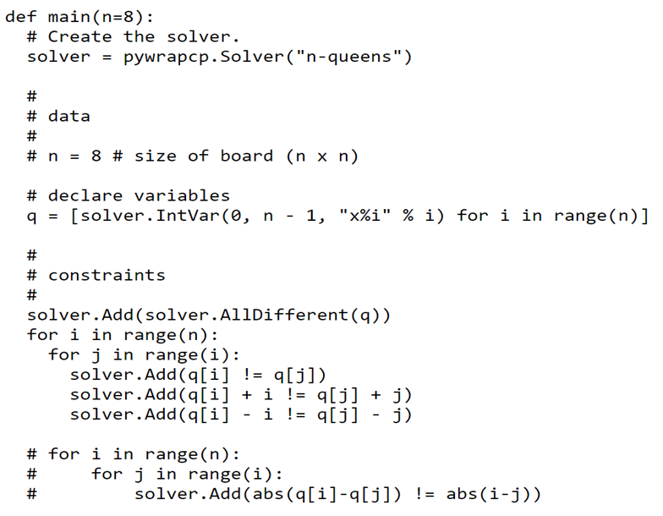
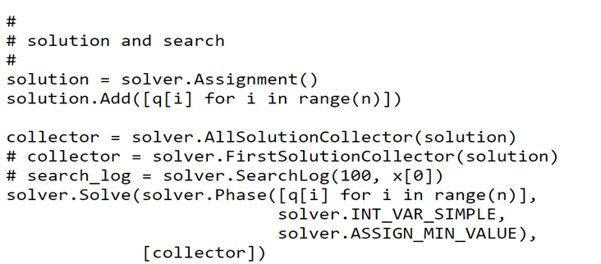
N-Queens problem in or-tools

Slide 16
The reality of CP
Most real problems are subject to ulterior complications, and things aren’t easy as Freuder hoped:
soft constraints
multi-objective optimisation
infinite domains such as time
complex discrete types, like intervals
Modelling is actually very hard and different models determine how effective a search method or heuristic can be.

Slide 17
A case study: General Electric Turbines

Slide 18
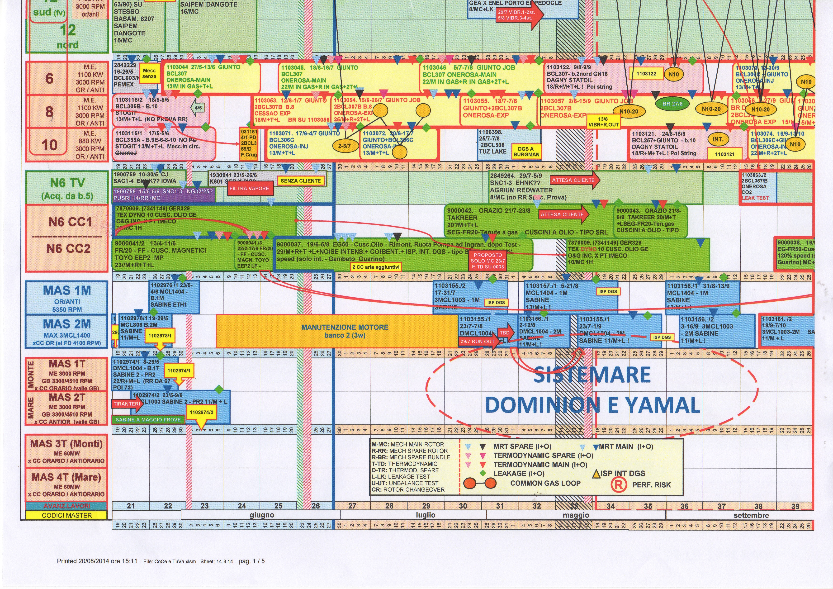
General Electric – planning the tests
Tests were planned with an excel file (left)
Changes were very difficult to accommodate
There was no warranty of correctness
Trial and error and what-if scenarios were impossible
Operators were not able to optimise solutions, and a lot of time and resources were wasted

Slide 19
Testing process Resources: -Testbeds / Motors -Gearboxes -Cooler loops
Testing turbines : modelling the problem

Slide 20
Matching Constraints A parallel machines, offline, non-preemptive multi-machine with processing sets scheduling problem with resource eligibility, release dates and due dates. (using Graham’s notation)
Testing turbines : modelling the problem
Notes:
Pinedo, Michael L. (2012). Scheduling. Theory, Algorithms, and Systems. Springer
Krzysztof Apt (2003). Constraint Programming. Cambridge
Frühwirth & Abdennadher (2003). Essentials of Constraint Programming. Springer

Slide 21
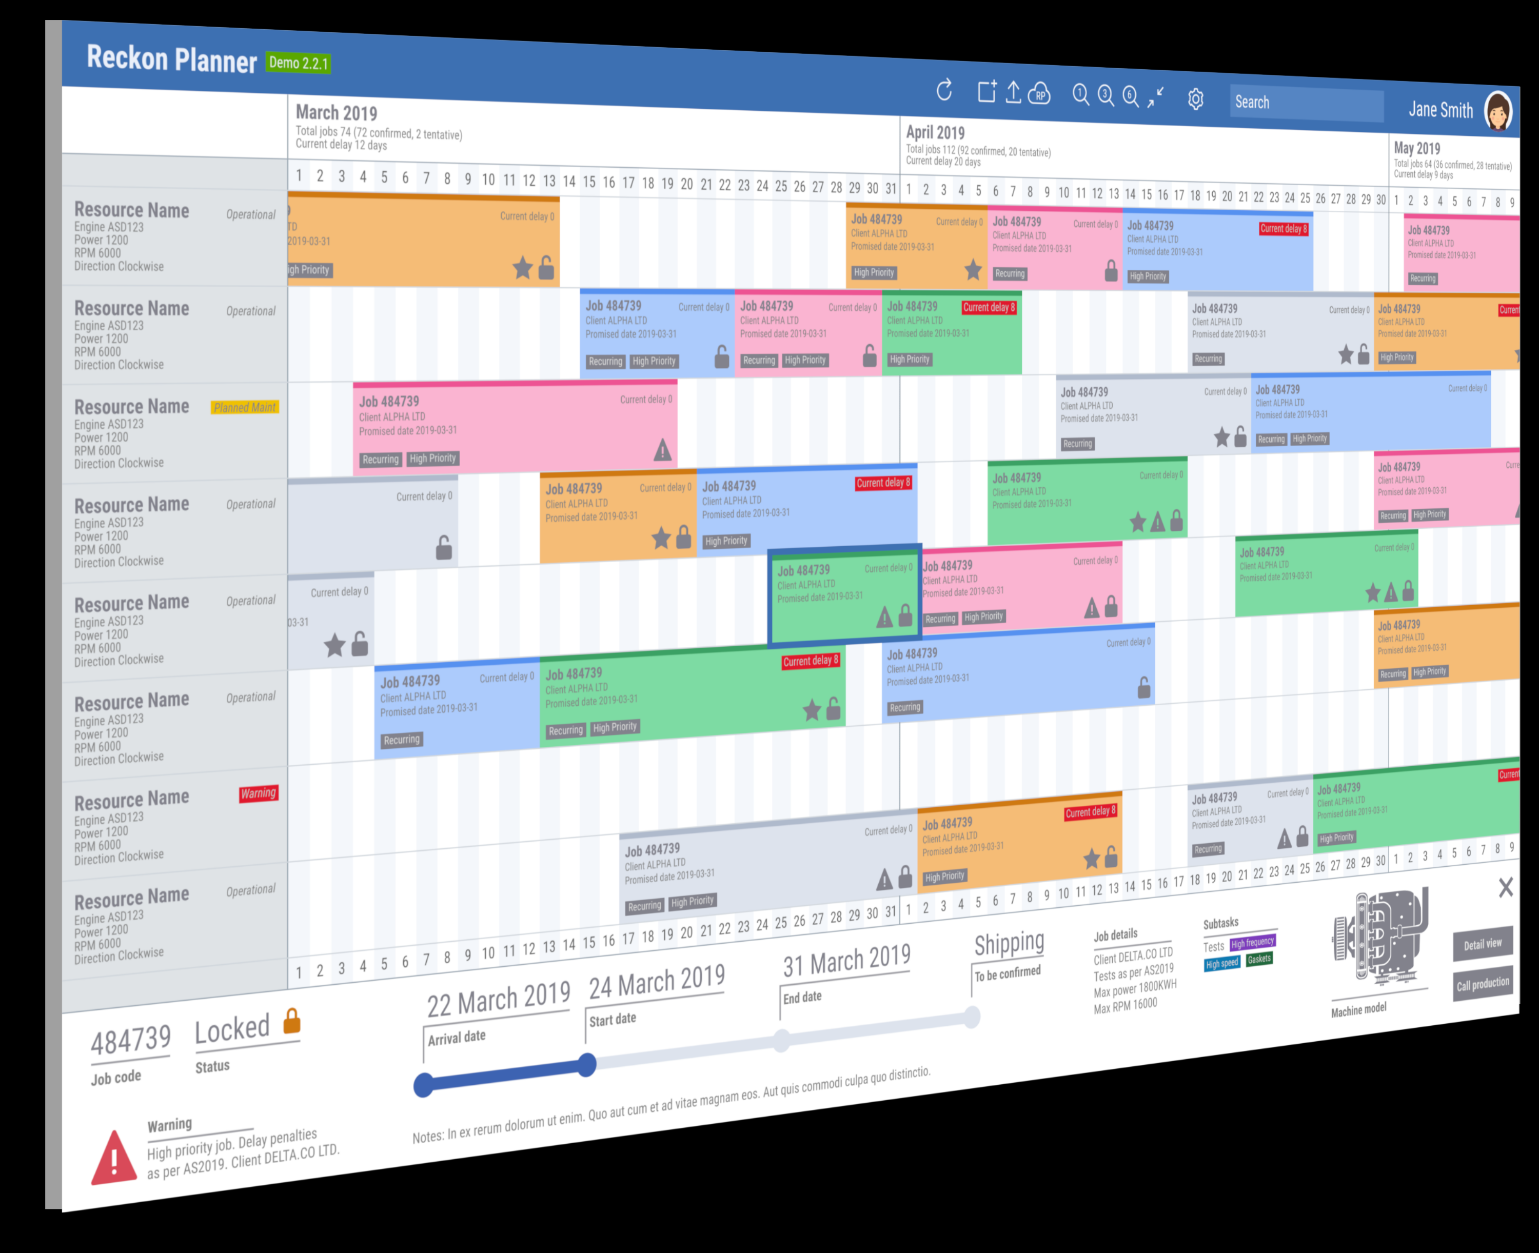
Stratagem
Already doing much better than humans and in use at GE for the past 4 years.
Uses a mix of or-tools and problem-specific construction heuristics.
Two areas of intense research:
Local search : problem of efficiently constructing neighbours of an assignment
Global search : problem of constructing viable operators on an assignment

Slide 22
To know more
Apt, Krzysztof (2003). Constraint Programming. Cambridge
Frühwirth & Abdennadher (2003). Essentials of Constraint Programming. Springer
Pinedo, Michael L. (2012). Scheduling. Theory, Algorithms, and Systems. Springer
Brucker, P & Knust, S. (2006). Complex Scheduling. Springer
Google or-tools: https://developers.google.com/optimization

Slide 23
Thanks.
@gabscali
gab@acm.org

