Slide 1
Predicting Academic Performance (Learning Dynamic Bayesian Networks)
Mashael Al-Luhaybi
Ph.D student in Machine Learning
Principal Supervisor: Dr Allan Tucker
Second Supervisor: Dr Stephen Swift

Slide 2
Presentation Outline
1
Aim & Objectives
2
Methodology
3
Experimental Results
4
Future Work

Slide 3
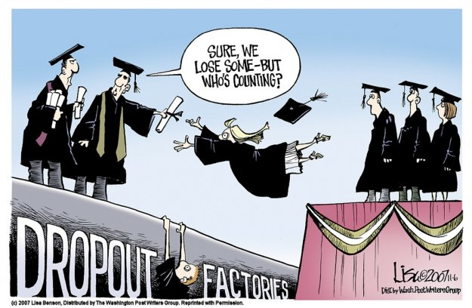
Data-driven AI?

Slide 4
Statistics
* The Higher Education Statistics Agency (HESA) in the UK
26,000
788,355 (2012/13)
757,300 (2016/17)
HE Qualifications
Drop out (England)
2015

Slide 5
Aim & Objectives
The essential aim of this research is to predict the academic performance of university students using probabilistic modelling taking into consideration the bias issue of educational datasets.
Objectives:
Identify the most predictive features (attributes) that affecting the prediction of students academic performance in higher education institutions.
Develop classification models (BNs) that predict students overall performance based on time series data & other extracted features from Blackboard learn.
Find solutions for imbalanced educational datasets.

Slide 6
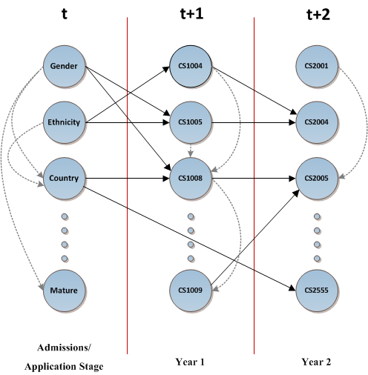
Methodology
Proposed Approach

Slide 7
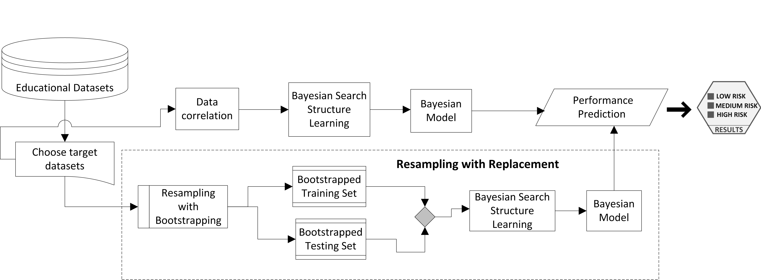
Methodology
Proposed Approach

Slide 8
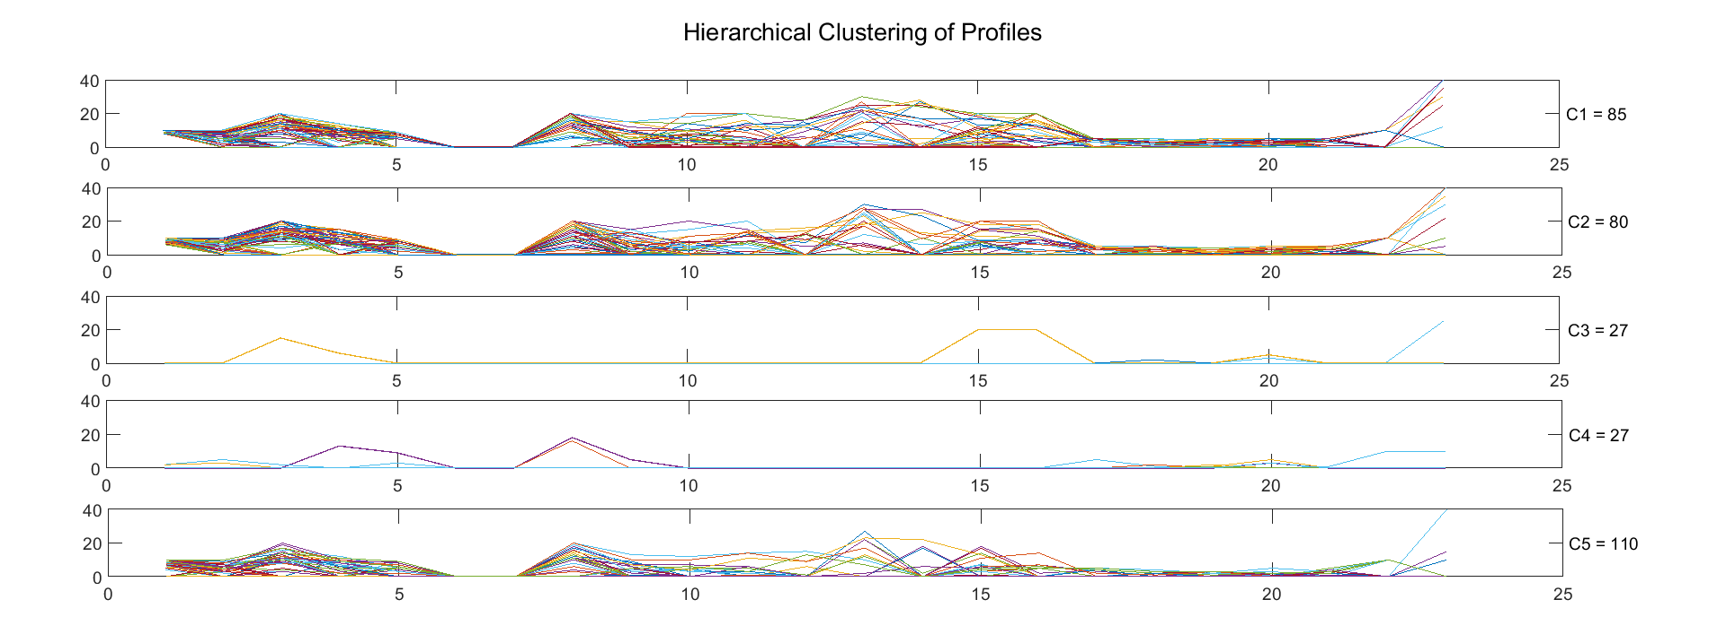
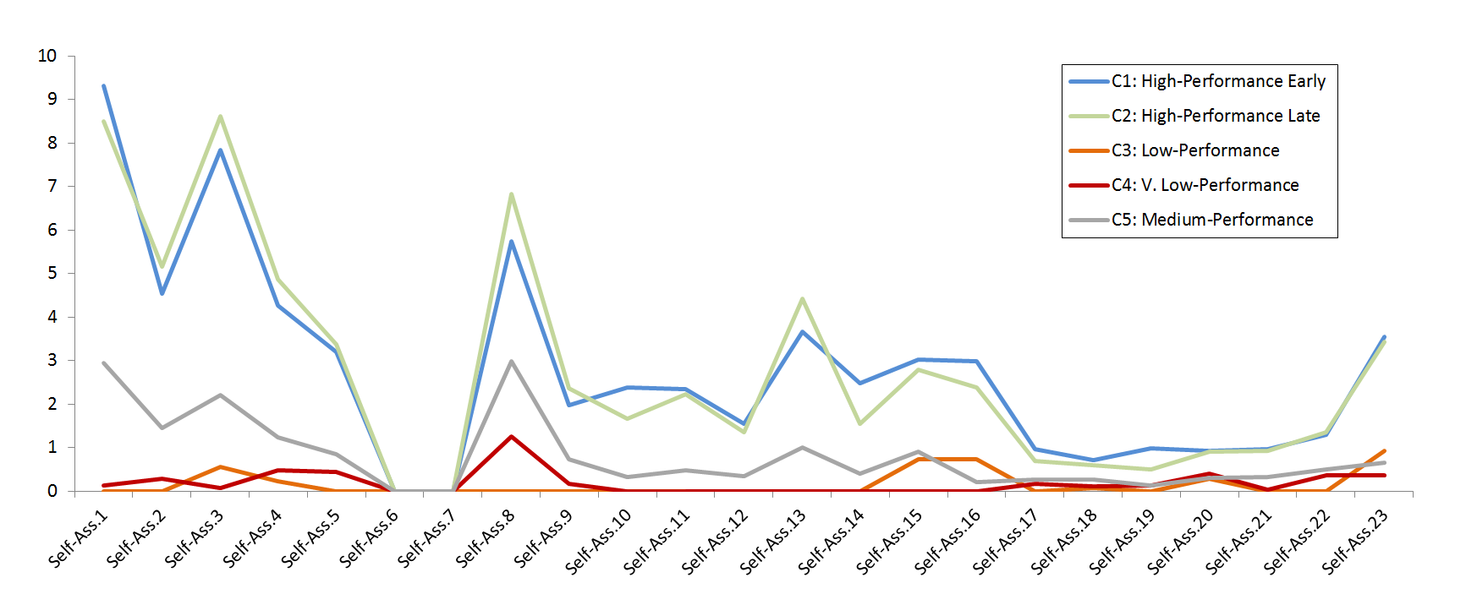
Experimental Results
1- Temporal Profiling Online Trajectories (DTW + Hierarchal Clustering)

Slide 9
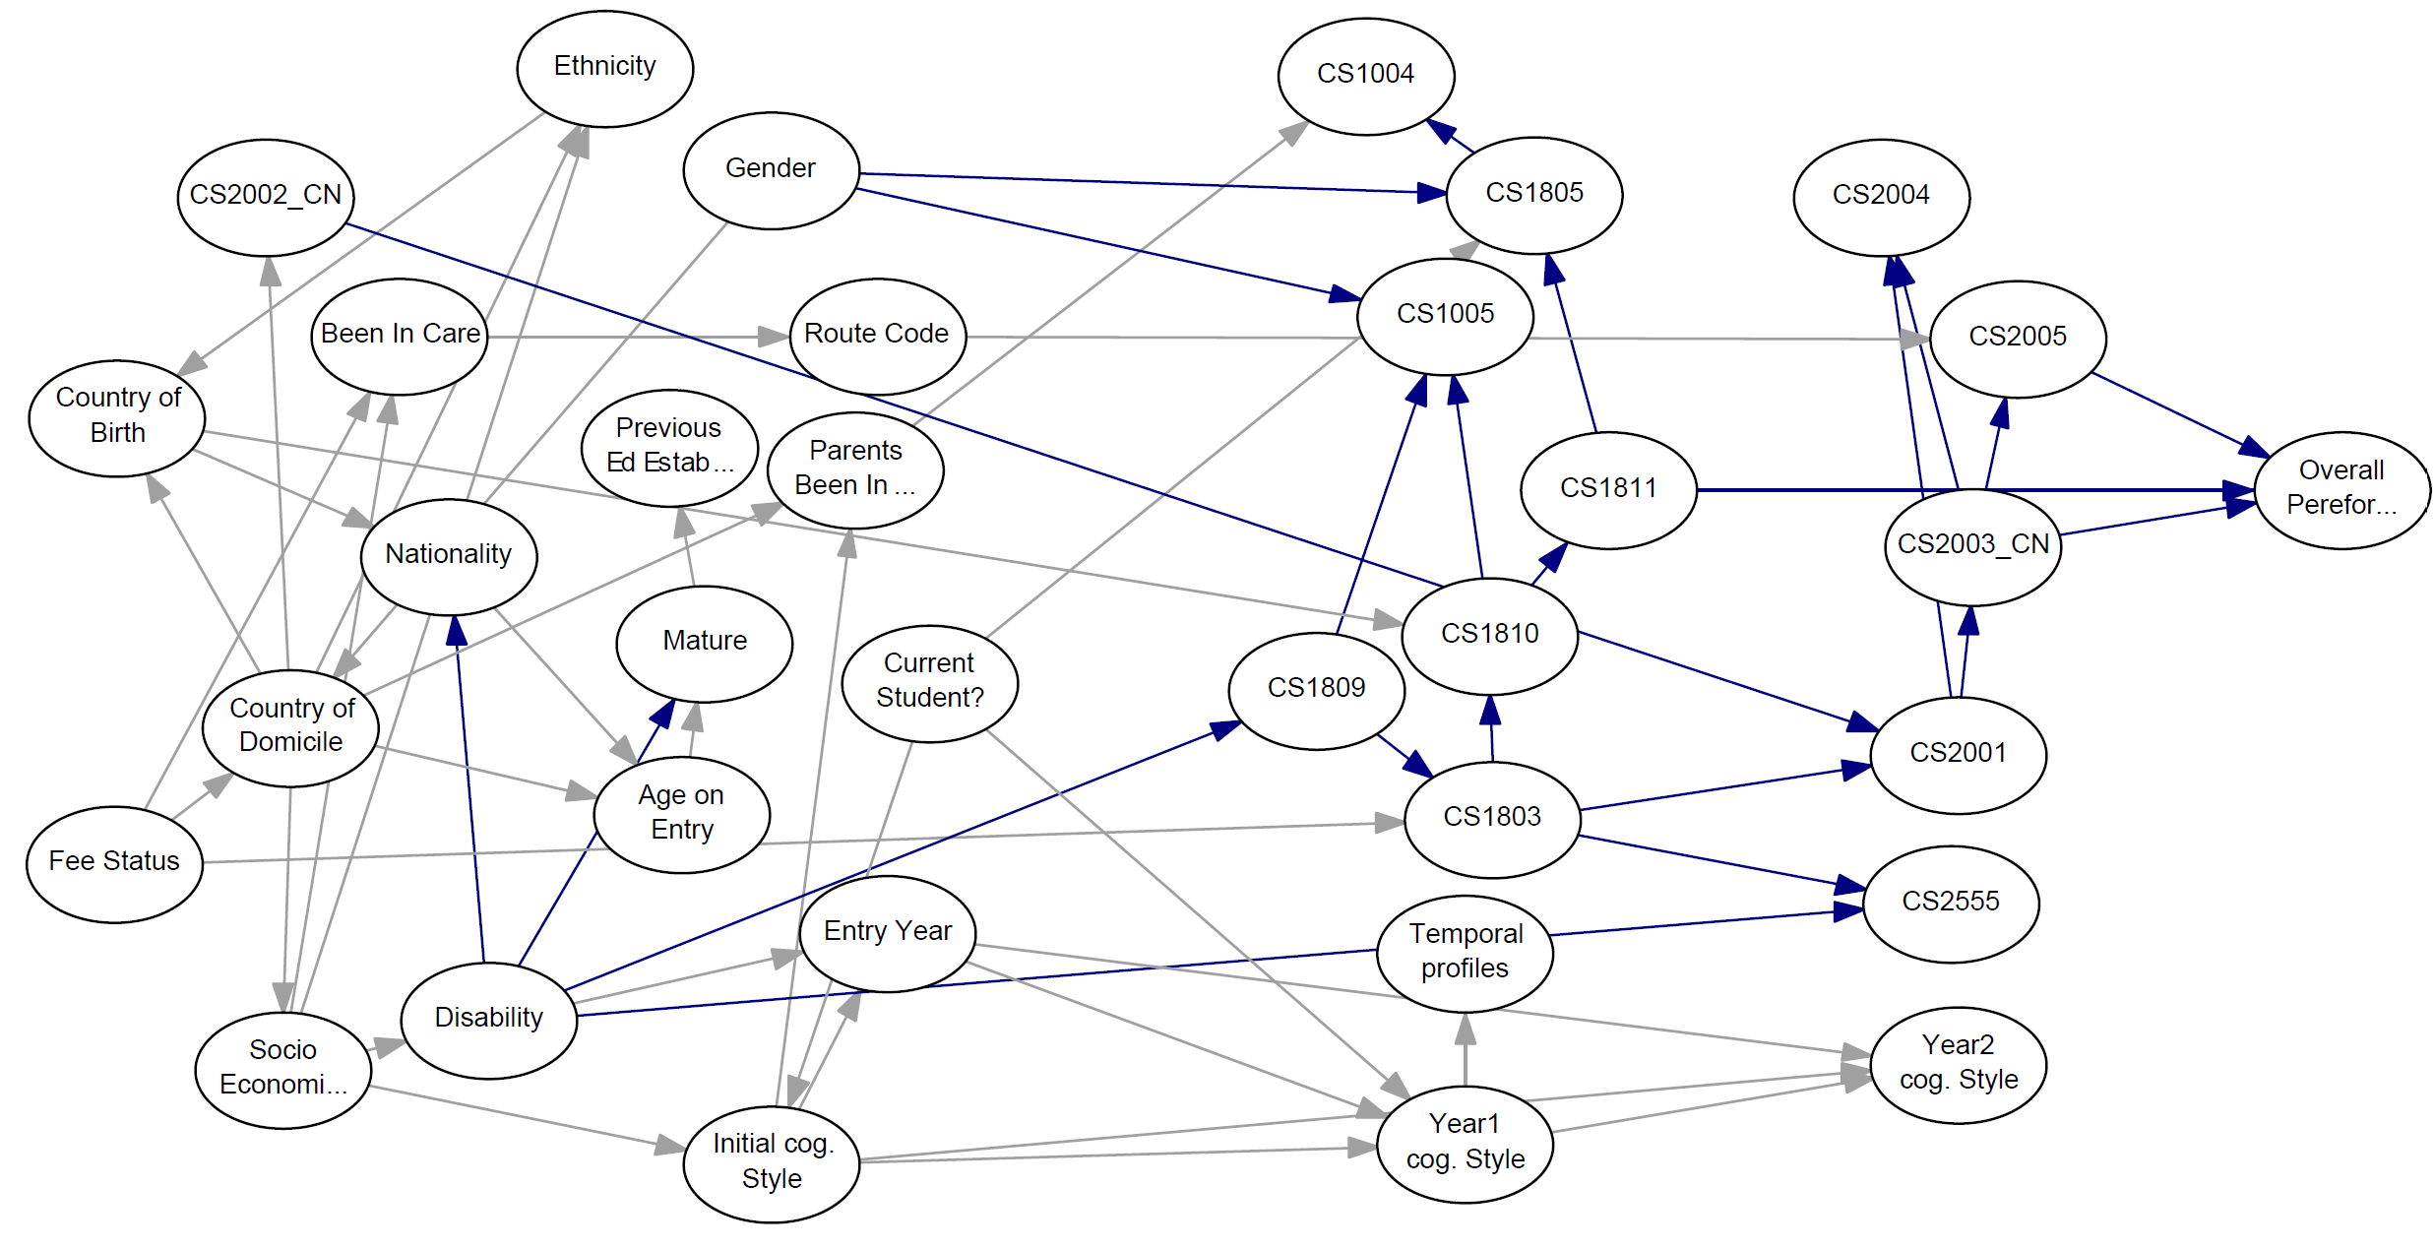
Experimental Results
2- Learning Bayesian Networks (Bootstrapped Educational data)

Slide 10
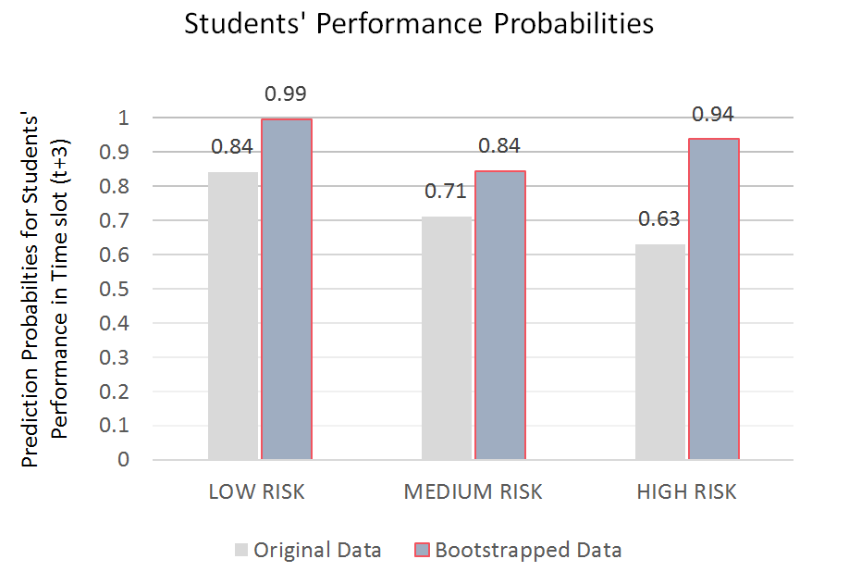
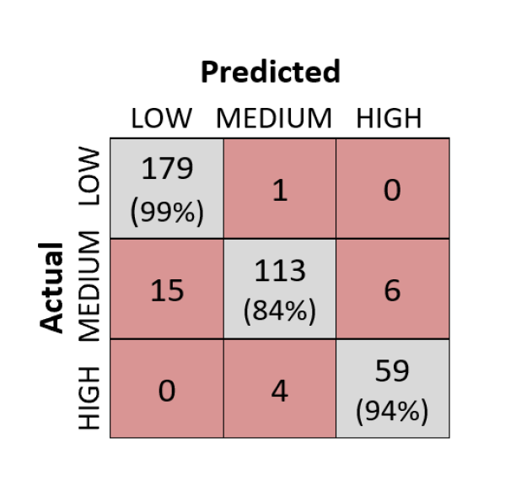
Experimental Results
Learning Bayesian Networks (Bootstrapped Educational data)

Slide 11
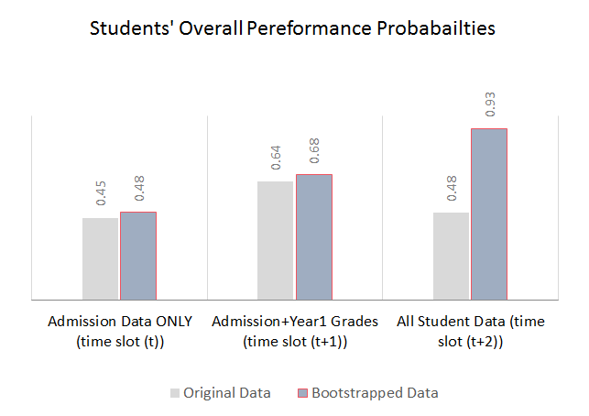
Experimental Results
Learning Bayesian Networks (Bootstrapped Educational data)

Slide 12
Future Work
Explore the extension of these Bayesian models with the investigation of latent attributes, with the aim of capture hidden factors that may influence the dynamics of students academic performance.
Compare our approach with other resampling approaches for time-series data (investigating Grade-based bootstrapping).
Explore some methods to solve bias issues of time-series dataset.

