Slide 1
Extracting Predictive Models from Flora Free-Text Documents at The Royal Botanic Gardens, Kew, London
Joanna Pawlik, PhD Candidate

Slide 2
Context
Habitat and Flora data from Kew Gardens, London,
Textual Data clustered and classified,
Analysis using R,
Main motivation: to create predictive models that, anticipate biodiversity loss.

Slide 3
First Experiment

Slide 4
Habitat Clustering

Slide 5
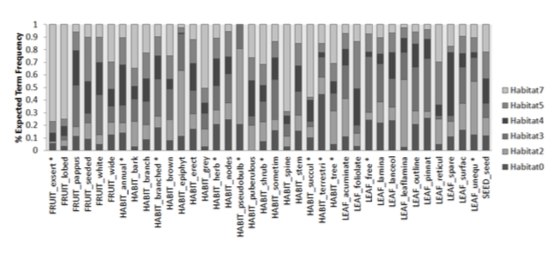
Habitat Classification

Slide 6
First Experiment Outcome
Notes:
Habitat cluster with floras how they are interconnected

Slide 7
Second Experiment
Our experiment has two stages:
Habitat Clustering We have explored probabilistic clustering to the habitat in order to identify different types of habitat.
Classification from flora traits using habitat cluster as the main predictor.
We used cross-validation to validate accuracy and confusion matrix to perform sensitivity test.

Slide 8
Initial Findings

Slide 9
Conclusion
Our experiment demonstrated predictive capabilities between flora traits and habitat cluster.
Our model proved that it is possible to predict plant’s traits directly from flora.
This means that we can predict families and species. The project will continue with other experiments such as identification of factors (including taxonomic and environmental) that influence biodiversity and stability of ecosystems.

Slide 10
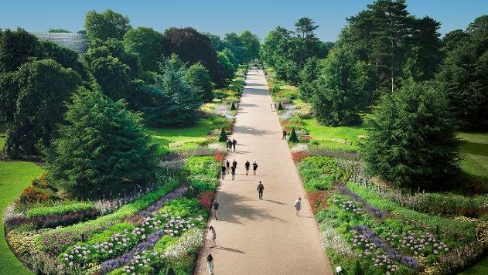
Thank you for your attention

