Slide 1
Level Set Segmentation of Retinal OCT Images
Bashir I dodo

Slide 2
Let us cross the river Thames
Figure 1: River Thames. (Credit: getty images)

Slide 3
Retinal layers on oct image
Figure 2: Location of Nerve Fibre Layer (NFL), Ganglion Cell Layer + Inner Plexiform Layer + Inner Nuclear Layer (GCL +IPL+ INL), Outer Plexiform Layer (OPL), Outer Nuclear Layer (ONL), Inner Segment (IS), Outer Segment (OS), Retinal Pigment Epithelium (RPE) and total retinal thickness on an OCT image.

Slide 4
Why oct segmentation?
Changes in the structure of retinal layers has been shown to highly correlate with the severity of various eye disorders, including glaucoma, age-related macular Degeneration and diabetic retinopathy.
Analysing the retinal layers has become an integral part of eye diagnosis in clinical ophthalmology.
Optical Coherence Tomography (OCT) is a non invasive method of obtaining high resolution images of the retina.
Segmenting retinal layers from OCT is a key element in the diagnostic process.

Slide 5
Method: Preprocessing
Figure 3: Preprocessing steps showing: Column 1 - Enhanced images; Column 2 - identified ILM (red) and RPE (Green); Column 3 - image masks; and Column 4 - Cropped images ; Row 1 - Nasal region; Row 2 - Foveal Region; and Row 3- Temporal Region

Slide 6
Method: initialisation
Eliminates the need for complicated strategies to handle background and noise during evolution.
Figure 4: (a) - Gradient of full image ( Figure 2 - Column 1, Row 1) with background noise and layer-like structures in red. (b) - thresholded gradient of preprocessed (Figure 2 - Column 4, Row 1) image with ROI only

Slide 7
Method: initialisation
Handles the problem of incorrect segmentation due to poor initialisation by allowing the method to evolve near the actual region of interest.
$C_{b}$(x,y)
Figure 5: Edges of gradient image, (a) - before refinement and (b) - refined edges used for initialisation.

Slide 8
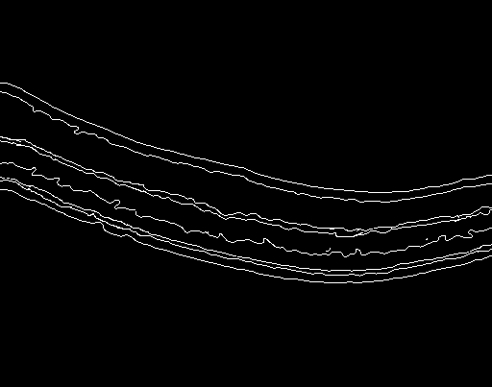
Topology Constraint
Each boundary point $C_{b}$(x,y) is limited to a maximum of “v” Expand or Shrink movements in the vertical direction from its initial point.
$C_{b}$(x,y)
Figure 6: Refined edges used for initialisation (same as figure 5 (b)).

Slide 9
Result
The method is able to adapt to pathological inconsistency of the retinal layers.
Figure 7: From top to Bottom: results from Nasal, Foveal and Temporal regions.

Slide 10
Result
The NFL thickness is vital in diagnosing glaucoma, and our method’s performance for the NFL is reassuring.
Table 1: Mean and Standard Deviation (SD) of Dice Coefficient on 200 B-Scans. (Units in pixels)
Retinal Layer | Mean (SD)
Nerve Fibre Layer (NFL) | 0.951(±0.022)
Ganglion Cell Layer + Inner Plexiform Layer + Inner Nuclear Layer (GCL +IPL+ INL) | 0.879 (±0.031)
Outer Plexiform Layer (OPL) | 0.892(±0.032)
Outer Nuclear Layer (ONL) | 0.907(±0.030)
Inner Segment (IS) | 0.932(±0.017)
Outer Segment (OS) | 0.920(±0.028)
Retinal Pigment Epithelium (RPE) | 0.934(±0.021)

Slide 11
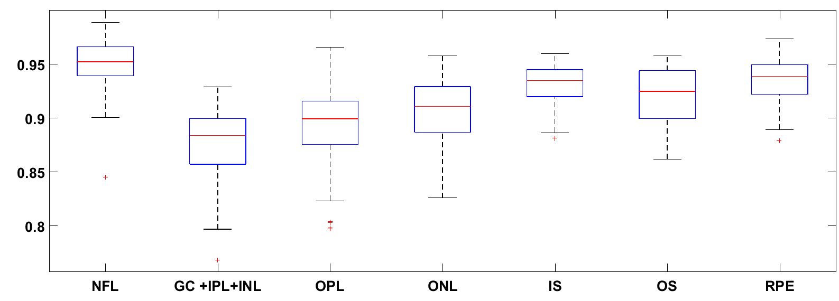
Result and discussion
The second quarterlies of the NFL, IS and RPE starting at ~0.900 further attests to the optimal performance.
Figure 7: Box plot of mean Dice Coefficient distribution for the seven (7) layers from Table 1.

Slide 12
Result and discussion
The proposed method takes advantage of handling the obstruction of image background noise in the pre-processing stage.
The refinement of the gradient edge information ensures only the targeted layers are initialised and evolved.
The topological constraints ensures the layered architecture of the retinal layers is preserved.

Slide 13
conclusion
The method successfully segments the OCT image into seven (7) non overlapping layers.
The method avoids over and under segmentation due to the layer initialisation and our topological constraints.
The structure and knowledge of the data is almost as important as the modelling. Understanding the structure is critical to the performance.
Future work will seek to include the GCL to IPL and choroid regions in the ROI.

