Slide 1



A sampling-based Clustering Scheme for Large Data Sets
^{Afees Odebode}

Slide 2
Outline
Introduction
Motivation
Background Knowledge
Sampling-based clustering
Conclusion

Slide 3
Introduction
Data is generated from various sources (Volume)
Variety of data generated required varied data mining techniques for the different domains (Variety)
The rate of data generation is phenomenal ( Velocity)
Data Sources
Manufacturing
Industry
Energy
Industry
Transportation
Industry
Cybersecurity

Slide 4
Motivation
Millions of records are daily been collected from different sources
Organizing data into meaningful information using traditional methods are no longer effective
Traditional methods are inadequate in handling large data sets
Data analytics and clustering methods need to be improved

Slide 5
Background Knowledge & Related Work
Clustering techniques are employed to group data
K-Means/CLARA/PAM/DBSCAN are widely accepted clustering techniques
Not effective in terms of anomaly detection and it may not scale well
Fails to converge to an optimum, if dataset is not well separated

Slide 6
Fundamental Challenges in Clustering(A. K Jain, 2010)
What is a cluster?
What features should be used?
Should the data be normalized?
Does the data contain outliers?
How do we define the pair-wise similarity?
How many clusters are present in the data set?
Does the data have any clustering tendency? ( restated as clusterability in (Andreas, A et al, 2019))
Are the discovered clusters and partition valid?

Slide 7
Desirable Characteristics of Clusters(C. Henning, 2015)
Within-cluster dissimilarities should be small.
Between-cluster dissimilarities should be large.
Clusters should be fitted well by certain homogeneous probability models such as the Gaussian or a uniform distribution on a convex set, or by linear, time series or spatial process models.
Clusters should correspond to connected areas in data space with high density.
Features should be approximately independent within clusters.
.

Slide 8
Sampling-based clustering
How to solve anomaly detection issue?
  Introducing DBSCAN (Density-based Spatial Clustering of Applications with Noise) with K-Means.
  Combine K-Means with DBSCAN
How to solve the issue related to scale?
  Select a small but representative sample from entire dataset (1%, 2%,5%)
  Apply K-Means to identify the clusters and use it as labels
  Use DBSCAN to identify the dense regions and potential anomalies
  Remove potential anomalies.
  Use modified KNN (nearest-neighbour) to classify the rest of the data set
  Compare the result with K-means on the entire data set.

Slide 9
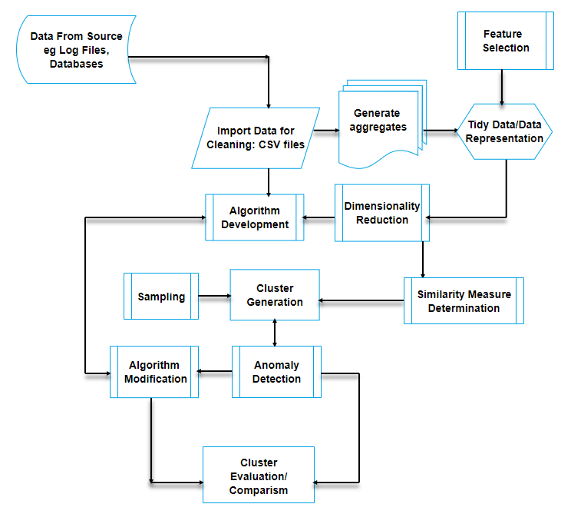
Simplified Data Processing and Clustering Process
Data Store
Data Cleaning
Data Aggregates
Clustering Engine
Anomaly Detection
Cluster Evaluation

Slide 10
References
Henning, C. (2015). What are the true clusters?. Pattern Recognition Letters, 64, 53-62.
Jain, A. K. (2010). Data clustering: 50 years beyond K-means. Pattern recognition letters, 31(8), 651-666.
Adolfsson, A., Ackerman, M., & Brownstein, N. C. (2019). To cluster, or not to cluster: An analysis of clusterability methods. Pattern Recognition, 88, 13-26.

Slide 11
Thank You

